Slide 1
Workgroup Updates
January 2020

Slide 2
Main Workgroups
Targeted Response Group- Work on ID&R Efforts as well as PD on site efforts
Professional Development
Technology
Dissemination
Check the status of each workgroup in the updated FII document

Slide 3
Form 3 IRRC PD Needs Assessment Survey
Online survey to determine areas of need for professional development related to eligibility, and recruitment strategies/techniques.
117 MEP staff/recruiters responded
Most respondents wanted PD to be face-to-face (53%) or via webinars (49%)

Slide 4
Eligibility PD Needs

Slide 5
Recruitment Strategies/Techniques PD Needs

Slide 6
Other PD Needs
Agribusiness connections
Relationship building techniques/building relationships with schools and employers
More scenarios
ID&R training for LEA coordinators
Time management
Safety

Slide 7
TRI Workgroup Projects
TRI- Recent Activities
Updated the TRI forms
Working to get direction on TRI efforts for this year.
Will help support efforts as they are requested.

Slide 8
Look ahead Year 5 TRI Projects
Do any of your states need help with TRI efforts this year?
Re-interviews? ID&R Efforts?
We are also looking at more PD available if needed for states.
Program structure, working with agribusinesses on the ground in your state, etc.

Slide 9
Recruitment Strategies/Techniques PD Needs
TRI Efforts Could Look like the following:
Experienced recruiter visiting with state lead recruiter and visiting employers and trying different strategies
On-site assistance to look at program and provide suggestions on program design or to review effectiveness of ID&R efforts
Data Technology Specialist working to provide ideas and solutions on how to streamline your data entry, collection, organization, etc.

Slide 10
Technology Group Project
Focused on the pilot
Wanted SST group to start the pilot and organize the structure for it in your state.
Determine who needs to be the person in your state to be added to the system.

Slide 11
Professional Development Group
Updating the mini quizzes
Developing new webinar resources
Conducting webinar trainings
Updating scenario banks
Creating content based on requests for PD

Slide 12
Dissemination
Keeping everyone informed of IRRC updates
Ag Trends Newsletters
Organization of website
Updating Content on site
Requesting feedback on specifics from SST and TST this month and next

Slide 14
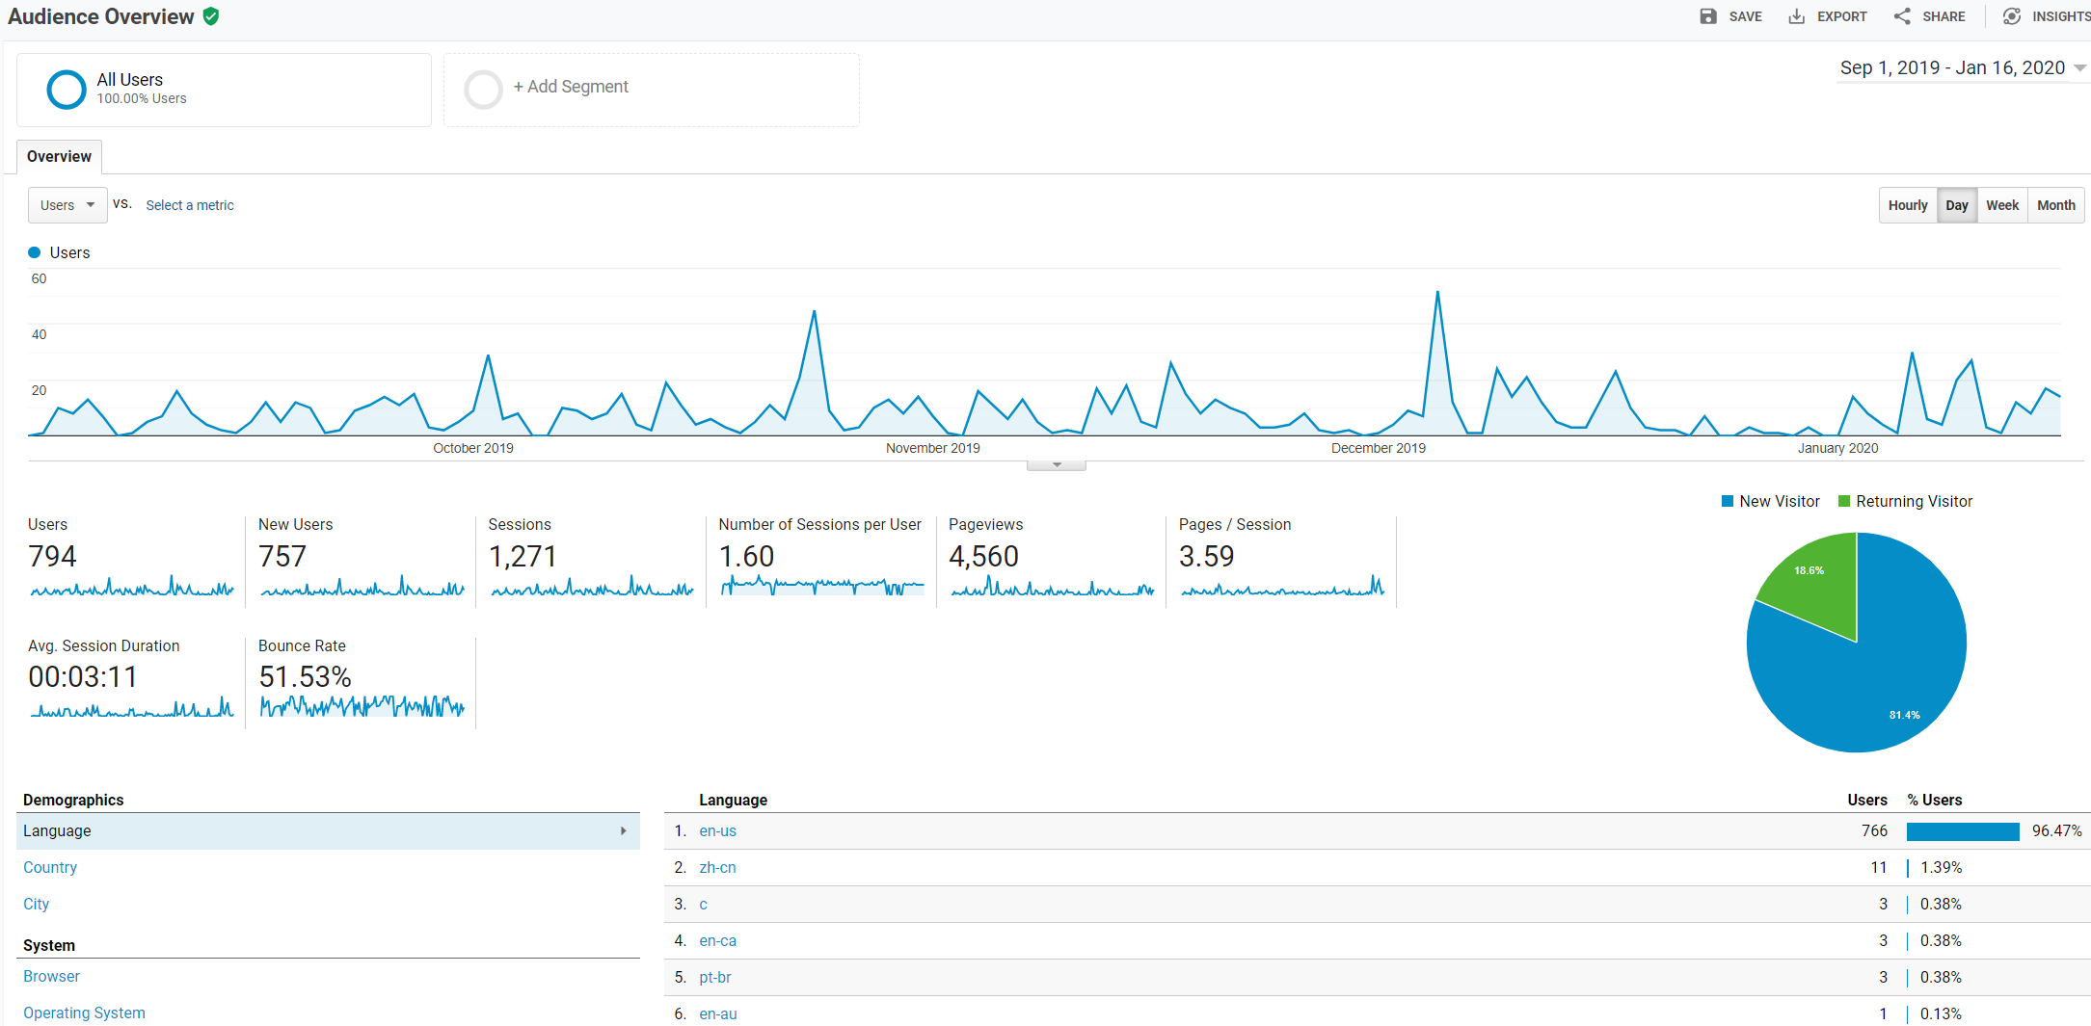

Slide 15
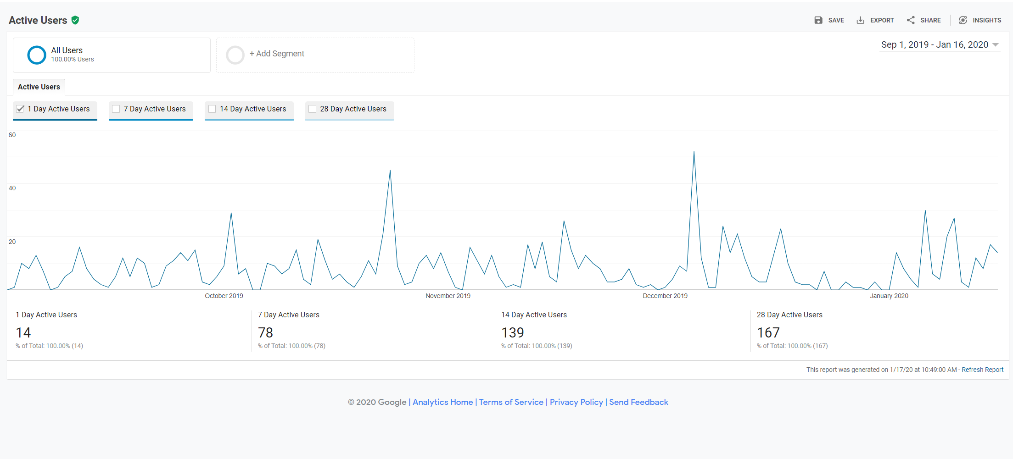

Slide 16
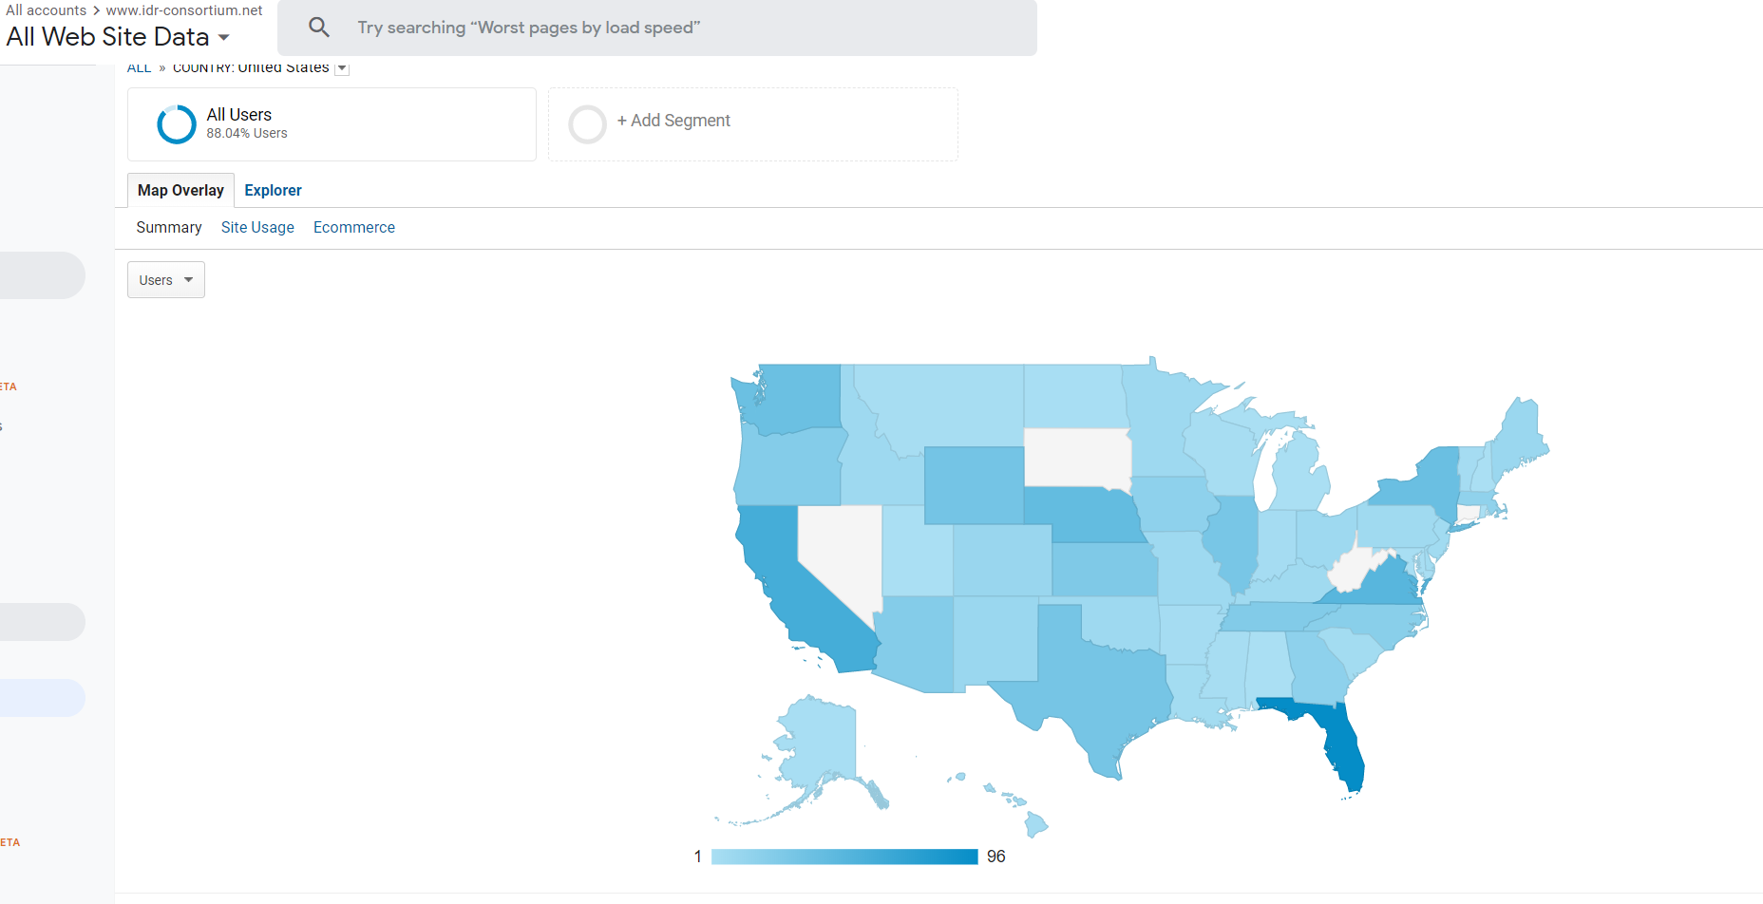

Slide 17
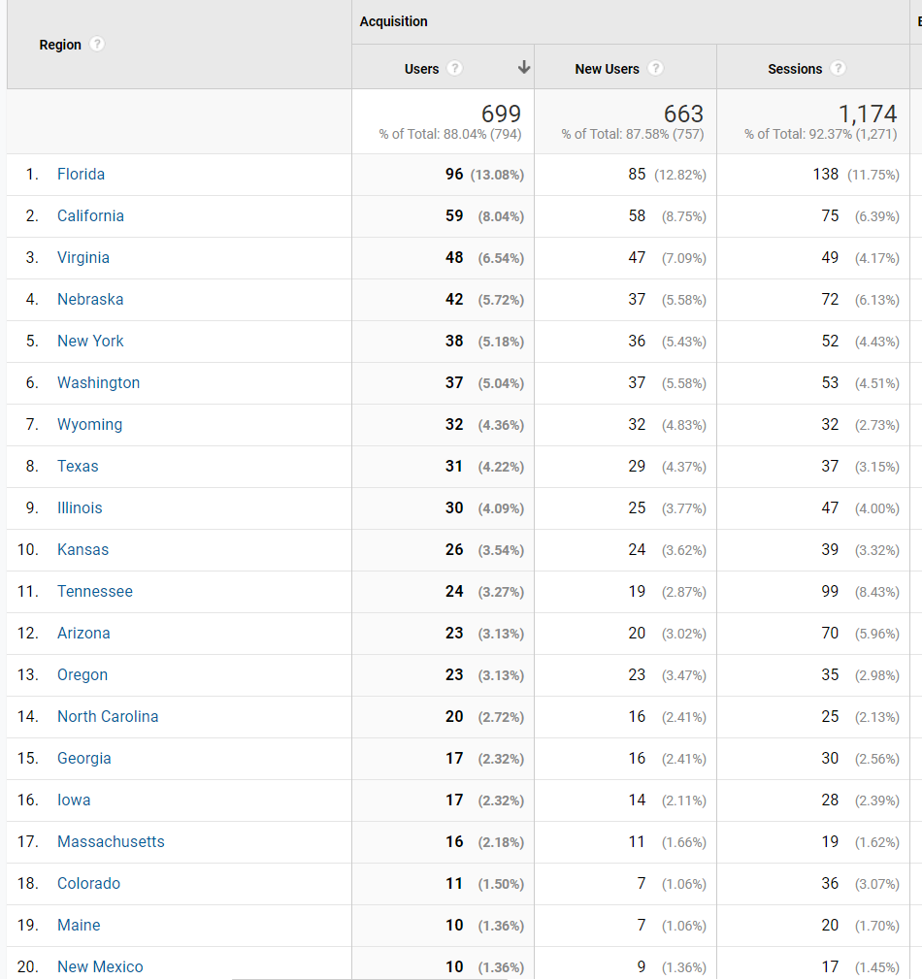

Slide 18
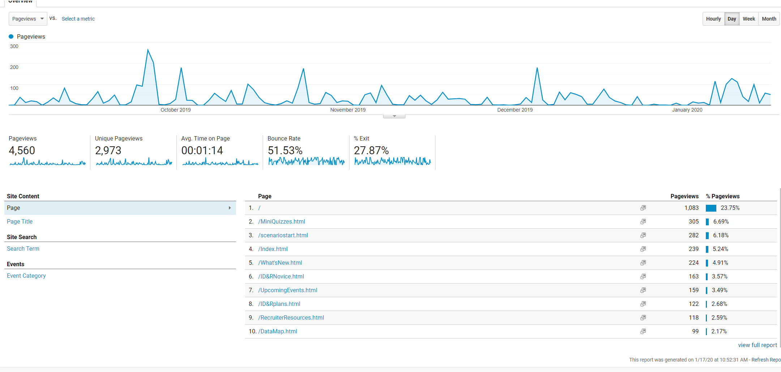

Slide 19
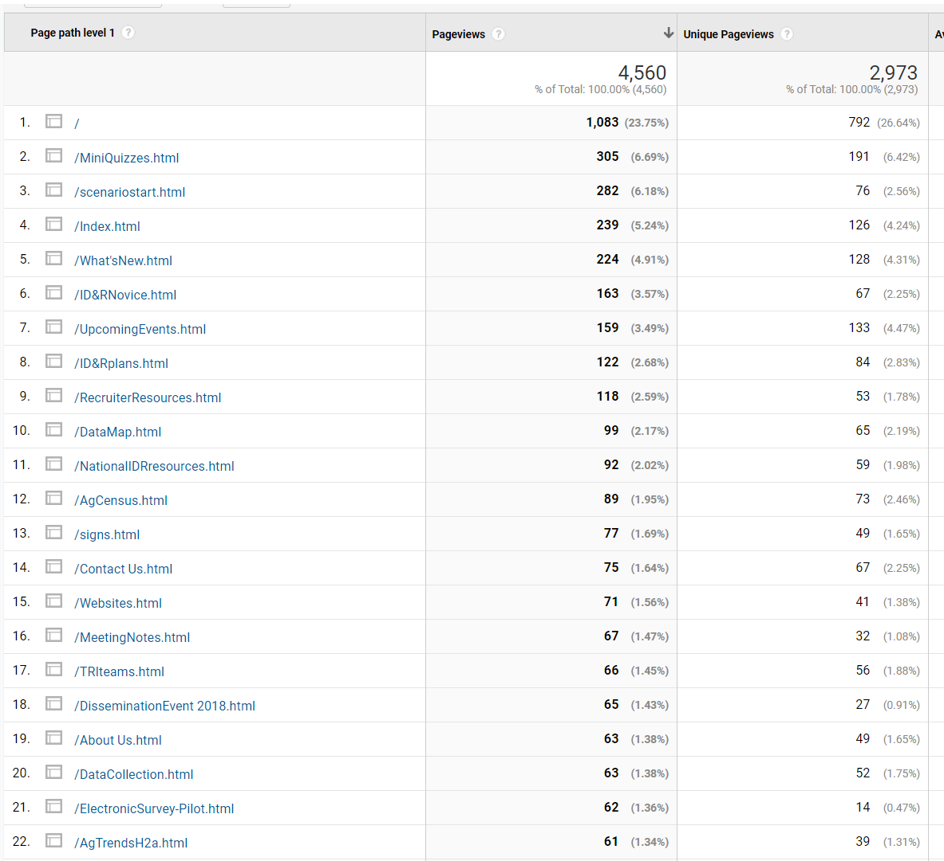

Slide 20
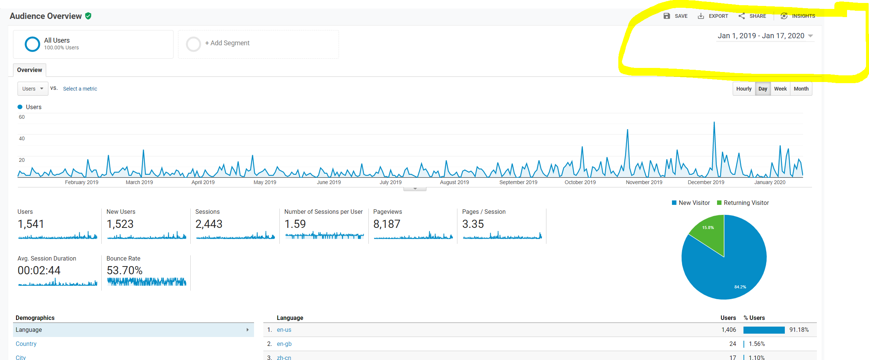

Slide 21
